Slide 1
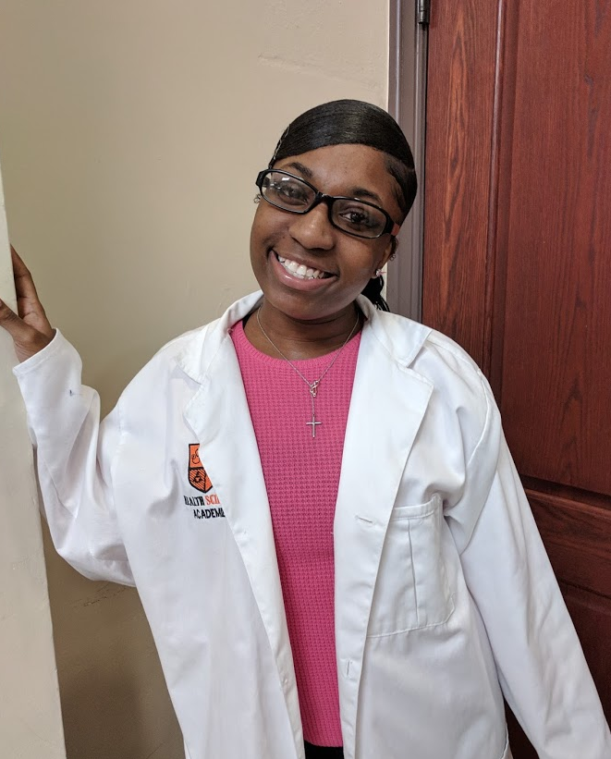
East High School
Health Science Academies

Slide 2
What are the Goals of the East High School Health Science Academy?
Increase academic performance
Create early college coursework, internships, and career exploration
Increase the number of students seeking advanced study in health science academic fields
Provide direct links between students and health science related jobs, college programs, and other certification programs

Slide 3
Careers in Health Sciences

Slide 4
Why should YOU care about health science careers?
One of the fastest growing job fields
There are over 14 million people employed in health care
There is an expected shortage of 18 million health workers by 2030

Slide 5
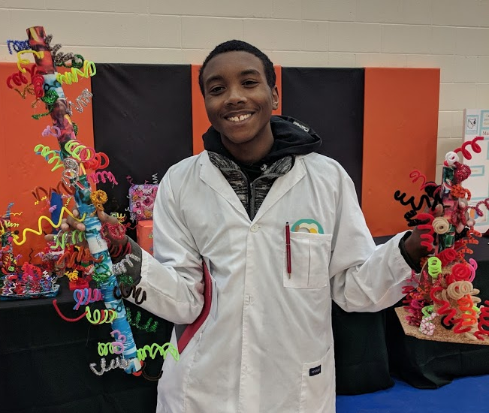
What Makes East High School a Health Science Academy?
EVERY STUDENT IS A MEMBER - Every student attending East HS is considered to be a part of the Health Science Academy.
CROSS CURRICULAR
COMMUNITY PARTNERS
BIOMEDICAL CLASSES
CAREER CONNECTIONS CLUB
ANNUAL WHOLE SCHOOL BOOK STUDY

Slide 6
Every East HS Student is a member of the Health Science Academy - Homecoming Parade

Slide 7
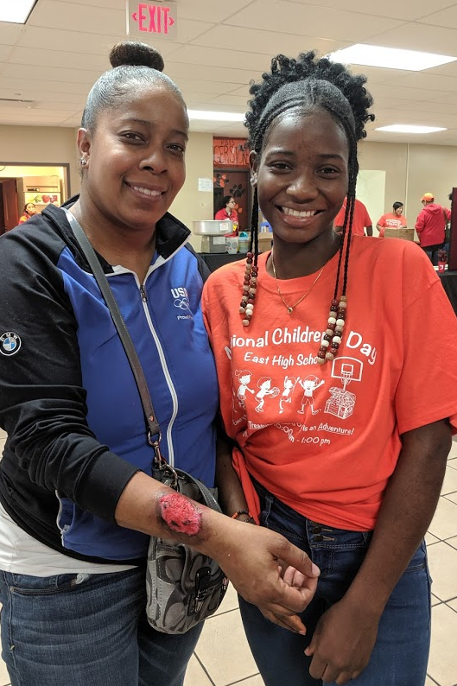
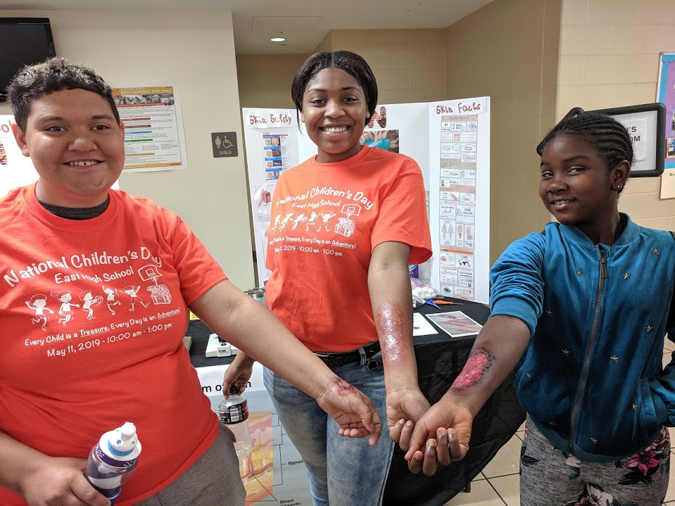
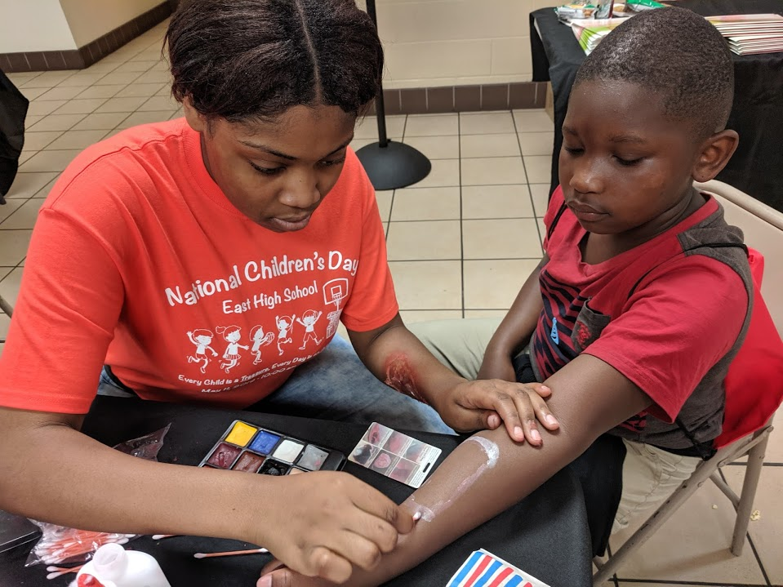
Every East HS Student is a member of the Health Science Academy - Children’s Day

Slide 8
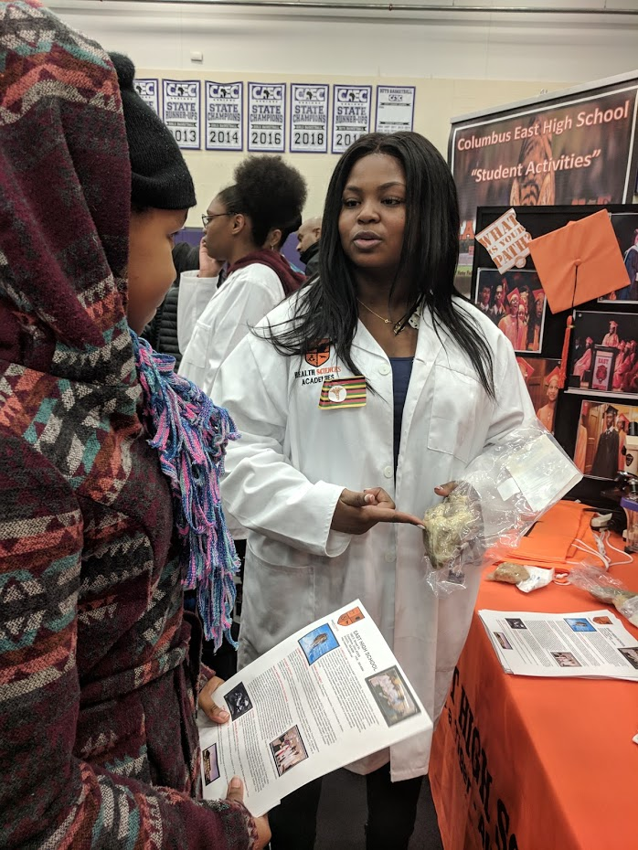
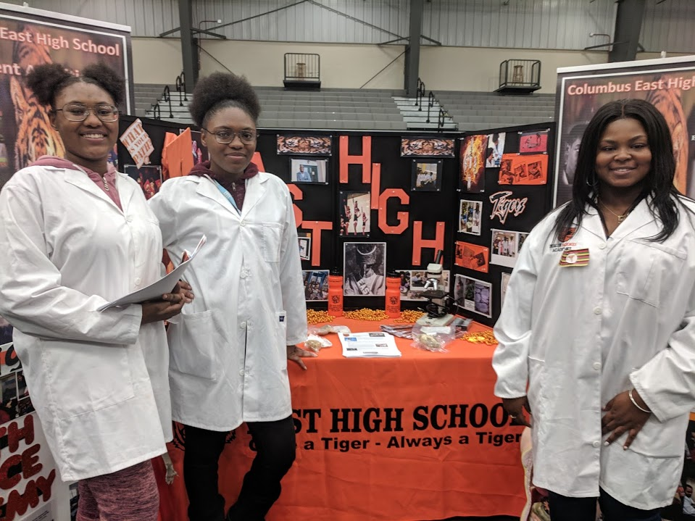
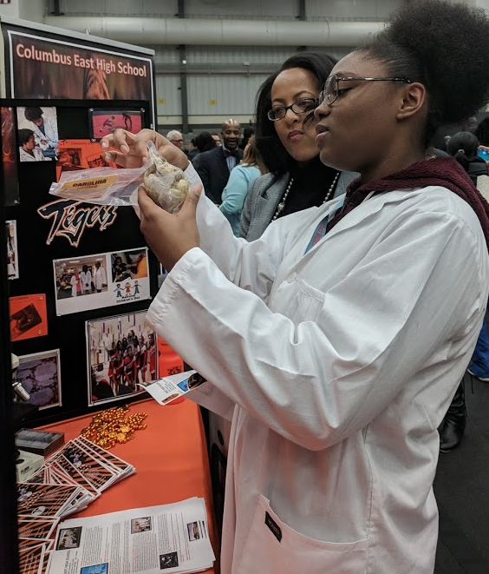
Every East HS Student is a member of the Health Science Academy - High School Fair

Slide 9
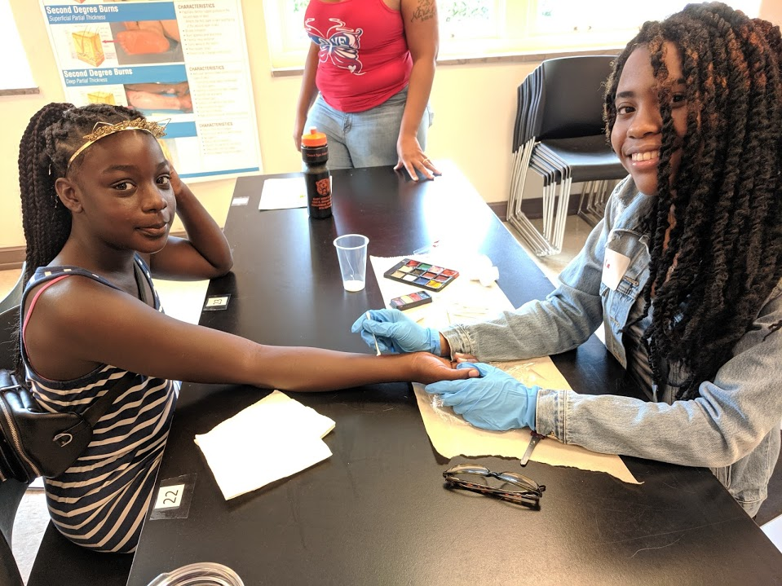
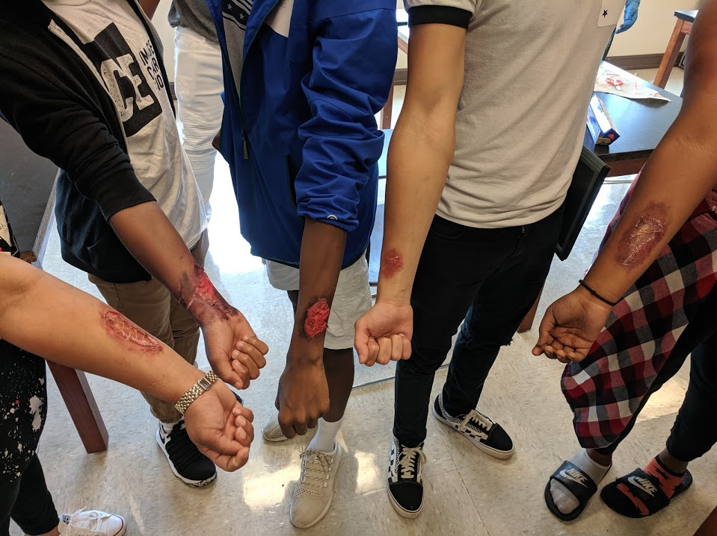
Every East HS Student is a member of the Health Science Academy - Freshman Orientation

Slide 10
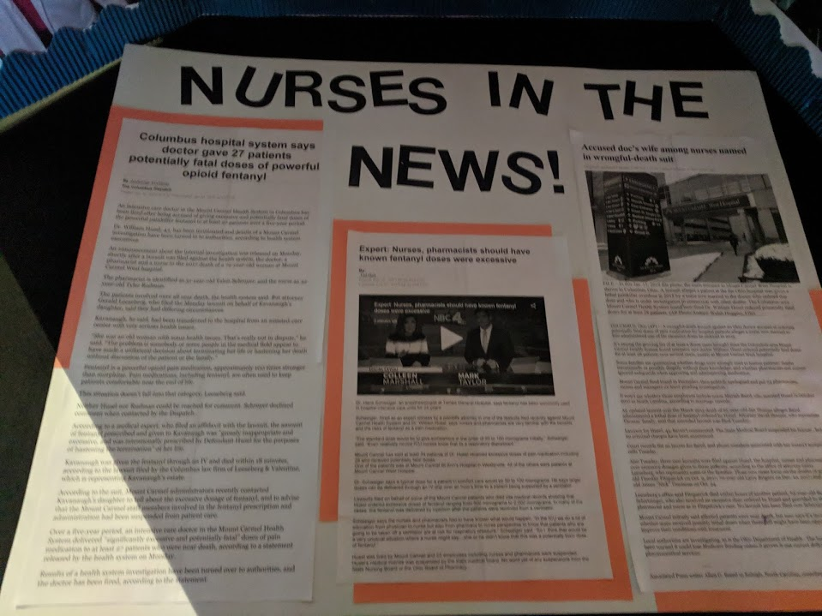
East High School Health Science Academy is Cross Curricular
Health science is integrated across the entire curriculum
Students learn about health science related information in EVERY class

Slide 11
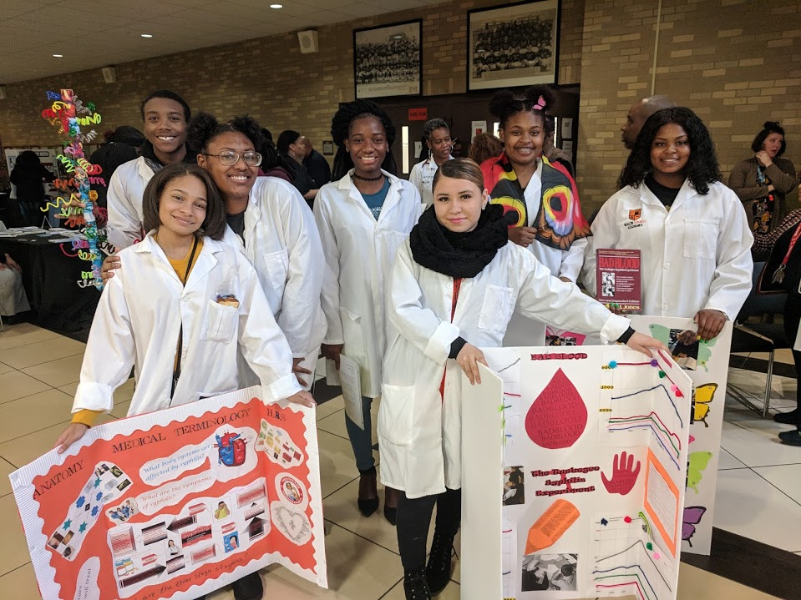
East High School Health Science Academy Whole School Book Study
A health science related BOOK is read each year by the entire school.
Each teacher showcases projects during an an end-of-year fair

Slide 12
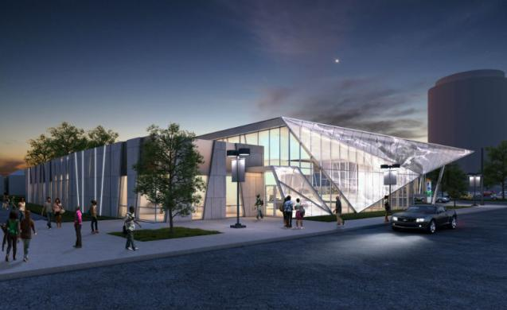
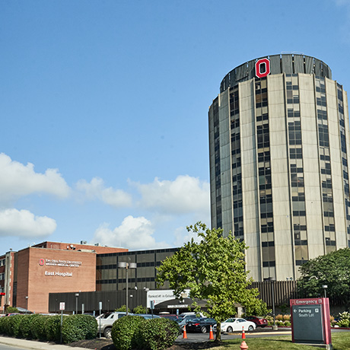
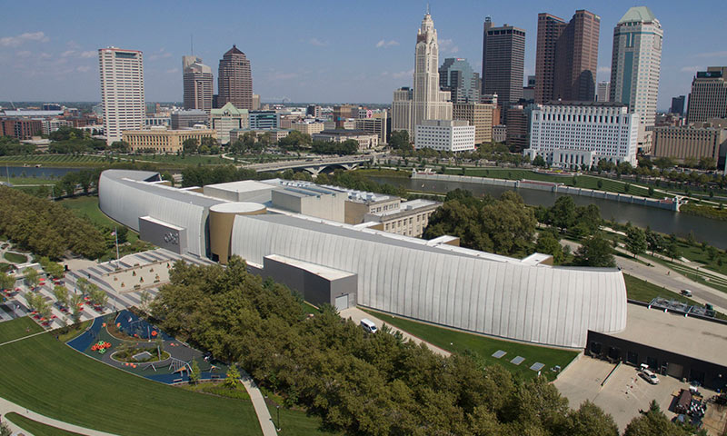
East High School Health Science Academy COMMUNITY PARTNERS
COSI
MLK Library
OSU Hospital East

Slide 13
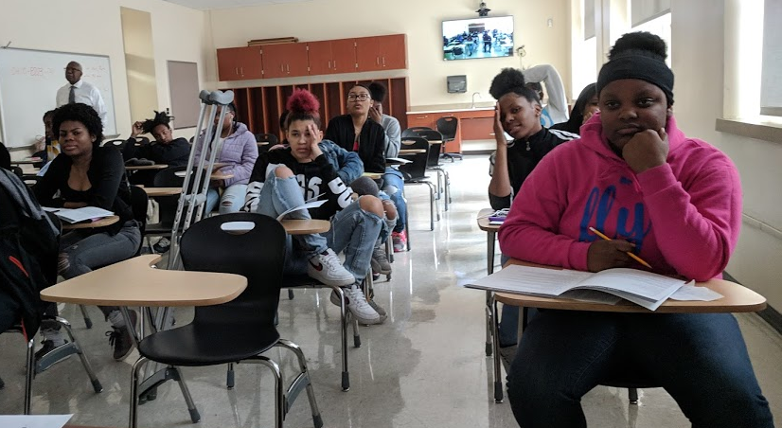
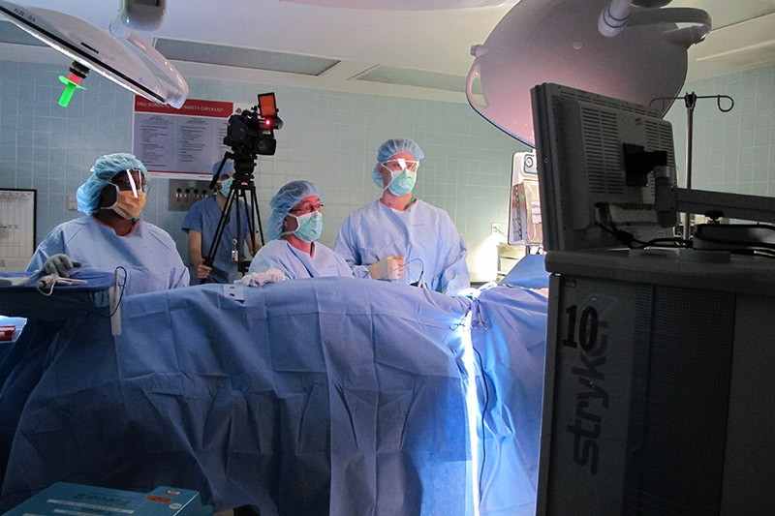
East High School Health Science Academy COMMUNITY PARTNERS - COSI
Interactive Videoconferences – Live Kidney Transplant, Autopsy, & Knee Replacement/ Careers in Pharmacy, Genetic Counseling & Forensic Psychology

Slide 14
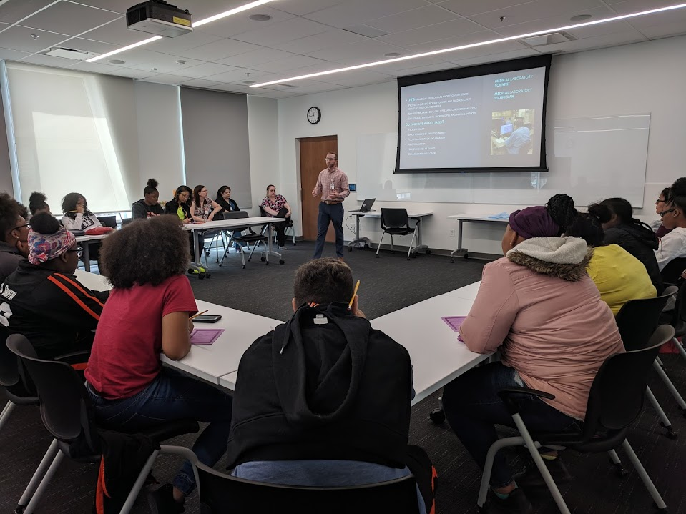
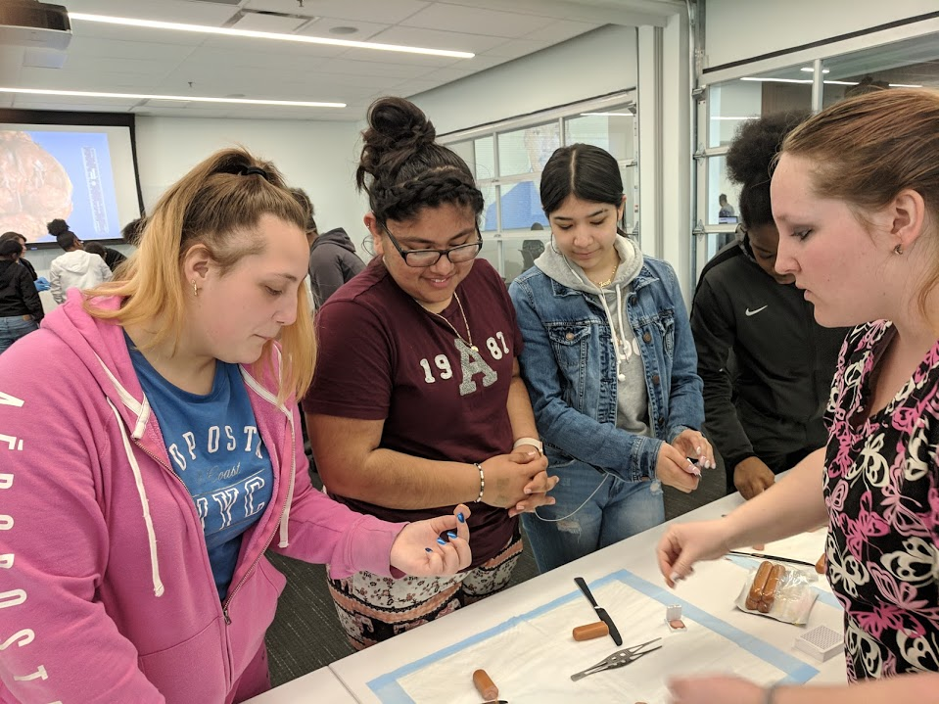
East High School Health Science Academy COMMUNITY PARTNERS - MLK LIBRARY – Science Cafe

Slide 15
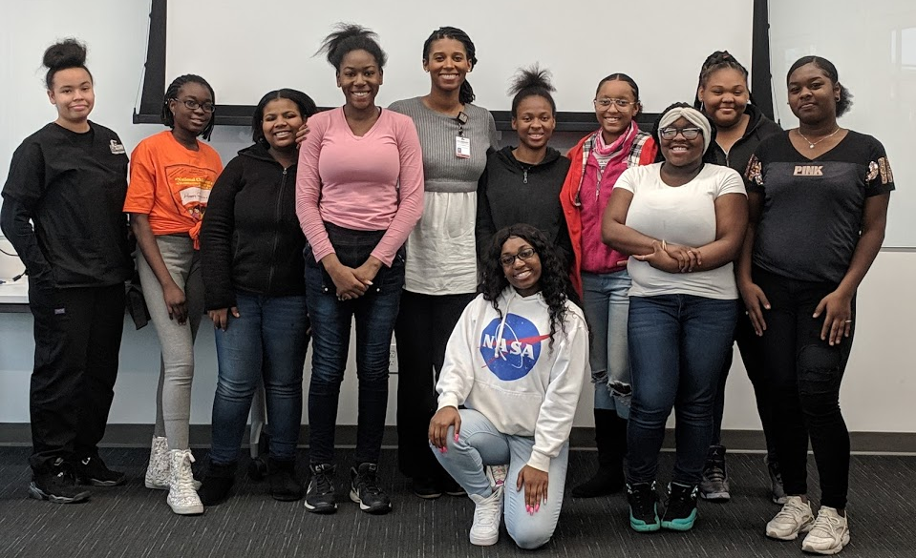
Science Café - Obstetrician

Slide 16
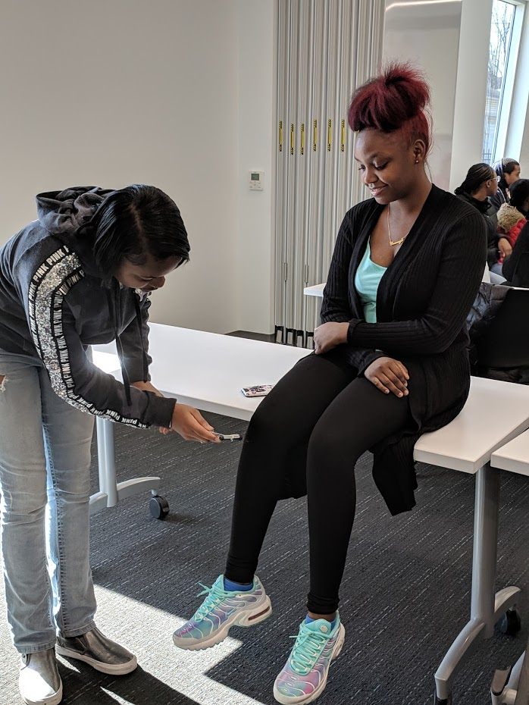
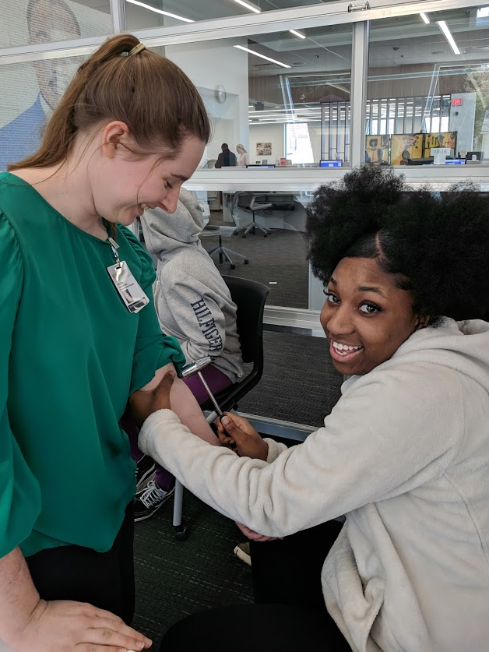
Science Café – Physical Therapist

Slide 17
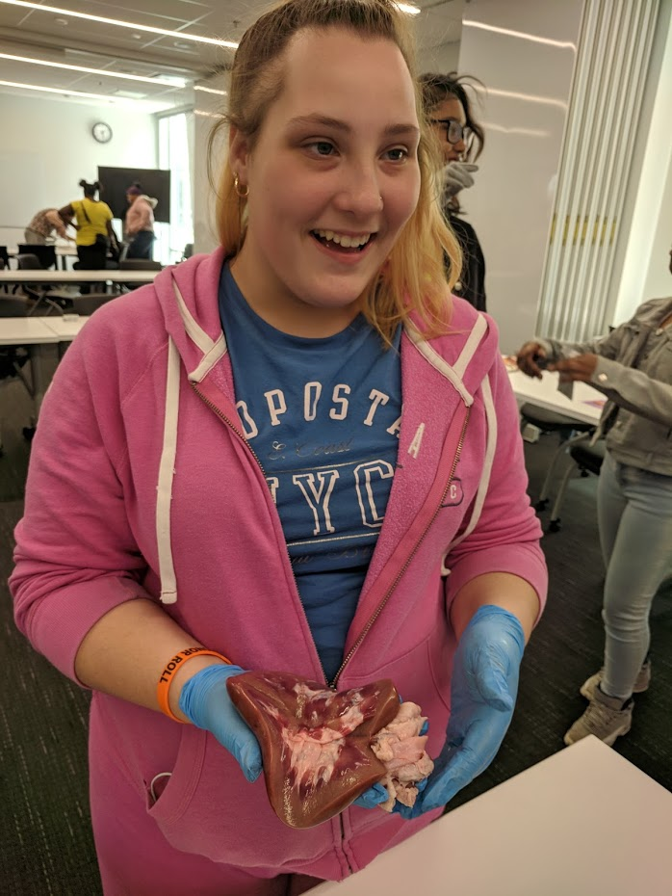
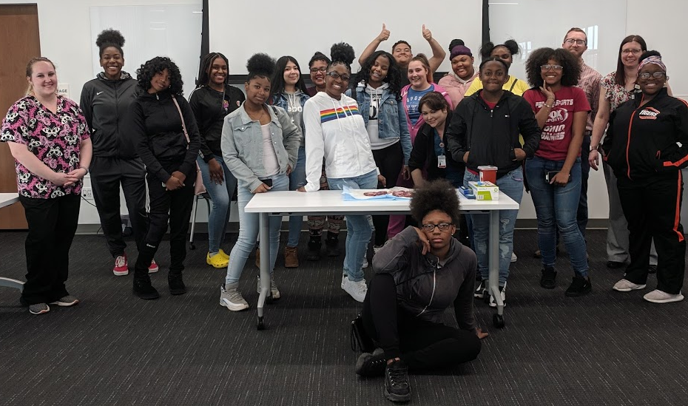
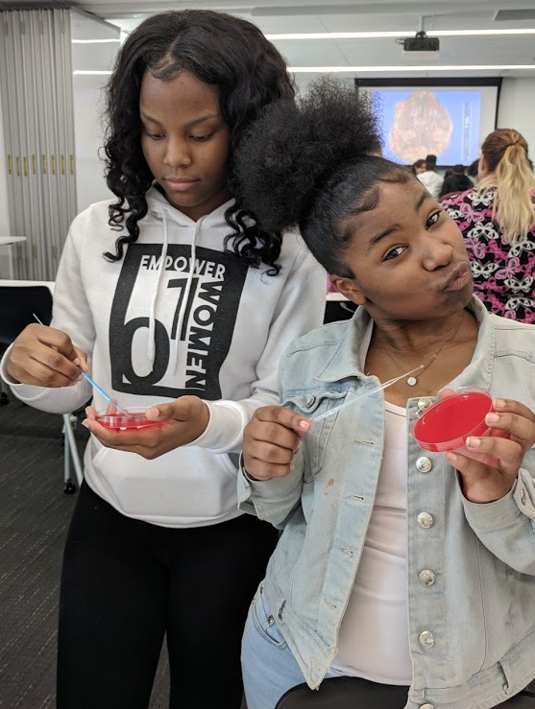
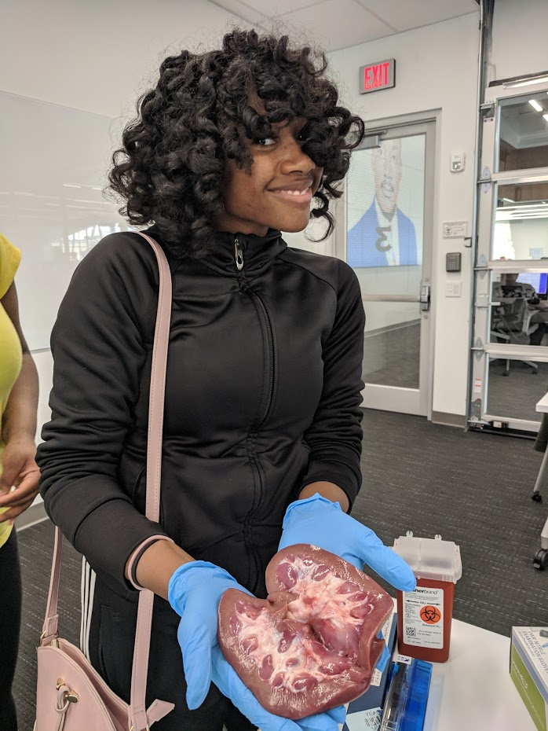
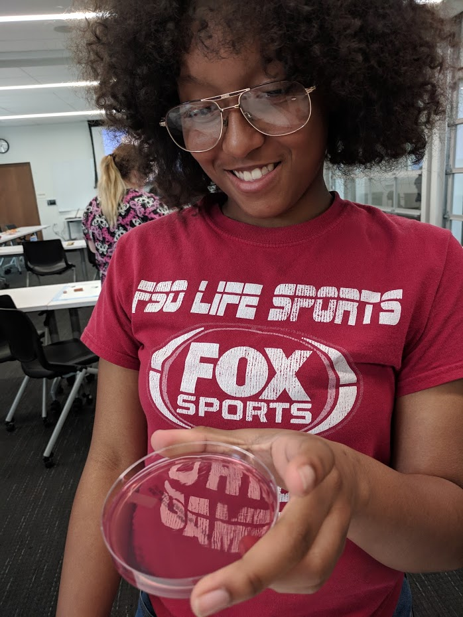
Science Café – Laboratory Technicians

Slide 18
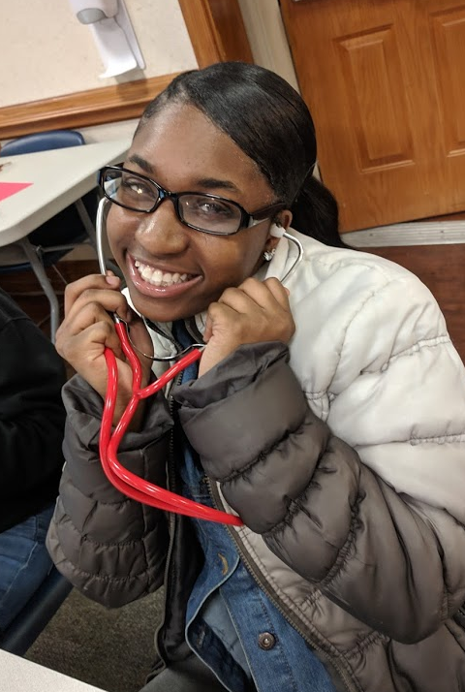
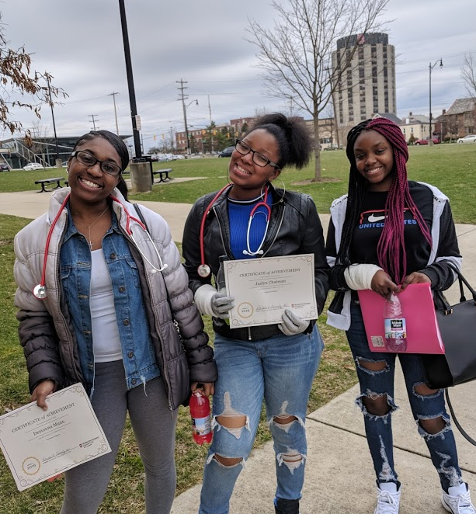
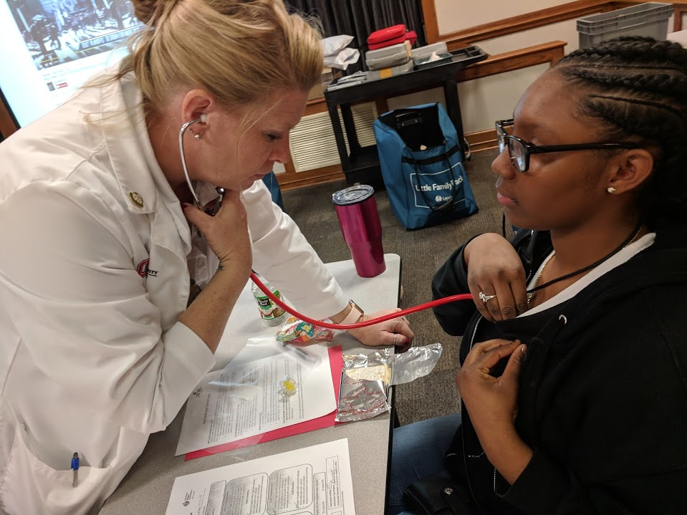
East High School Health Science Academy COMMUNITY PARTNERS – OSU Hospital East
OSU provides mentors, speakers, and CPR certification

Slide 19
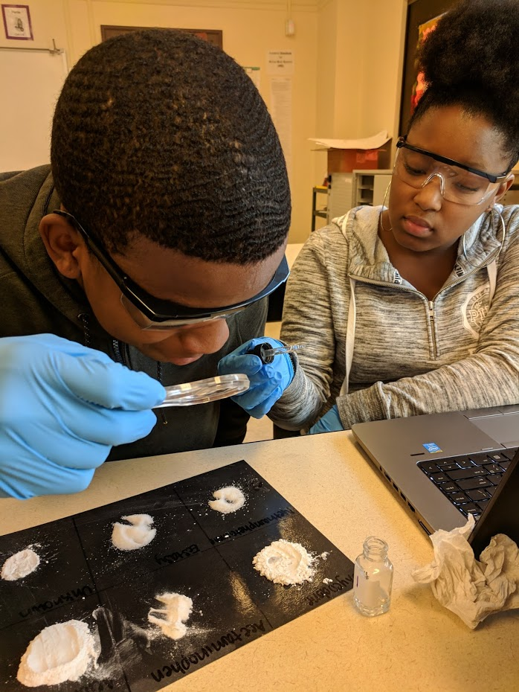
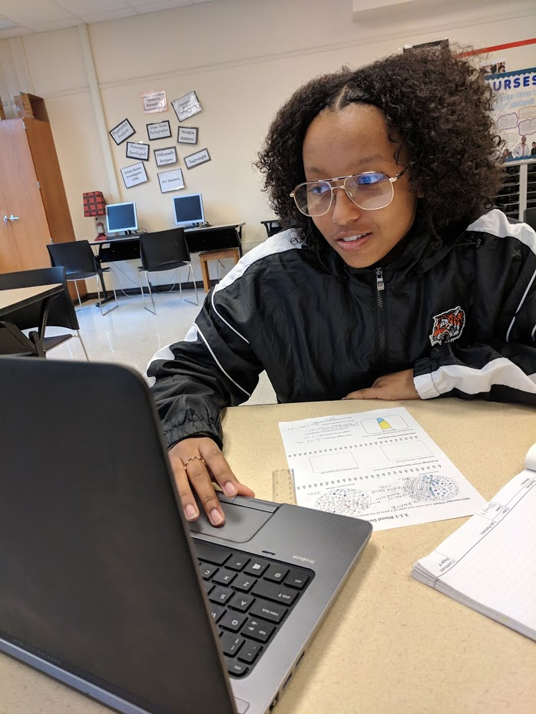
East High School Health Science Academy BIOMEDICAL CLASSES
There are 4 classes offered
1. Health Science Foundations
2. Principles of Biomedical Science
3. Human Body Systems
4. Medical Interventions
Students start with Health Science Foundations during freshman year, and end with Medical Interventions senior year, but we are flexible… if you want to join the program, we will find a way to fit you in!

Slide 20
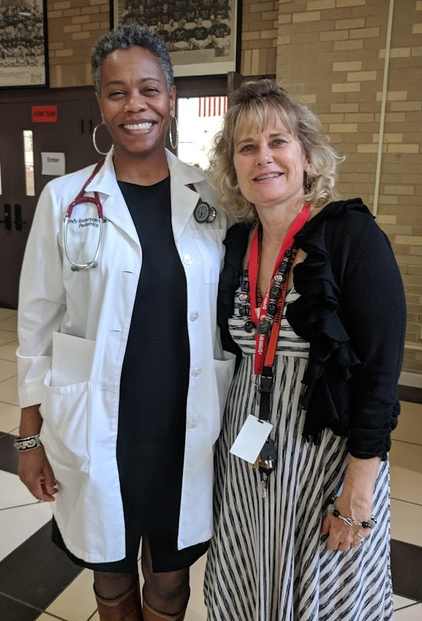
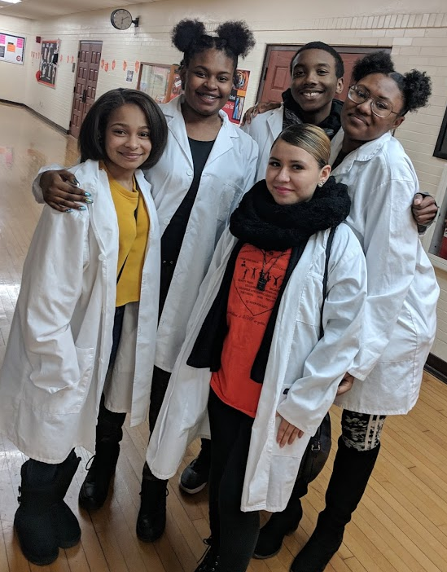
Health Science Career Connections Club Mentoring, Community Service, Career Exploration

